Slide 1
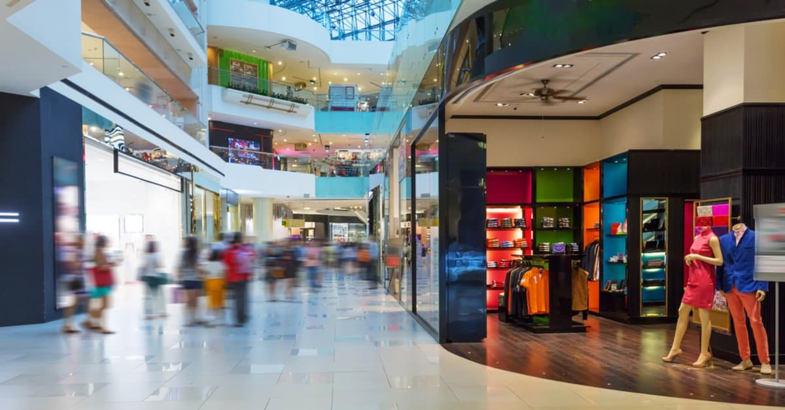

Digital Transformation Journey

Slide 2
12
AGENDA
1
Client Introduction
2
Client Issue
3
Digital Transformation Use Cases
4
Why Salesforce
5
Proposed Solution
6
Architecture
7
Impact

Slide 3
INTRODUCTION
Since launching in early 2012, Kinetic Fashions has grown into one of the largest store retailers of apparels and accessories. They have adapted their setup to form tight-knit team that is running the day to day operations at more than 180 hypermarket stores. Their motto is to never stop improving; they’re always learning and tweaking the trends with continuous customer feedback process collected at storefront.
Our passion is to create a wide range of fashion apparels for customer across different class and purposes. We have developed home grown range of products without compromising on any aspects of quality .
We always keep up with the current trend and update our inventory across the stores accordingly. Our journey doesn’t stop here and we plan to expand on the digital front providing hassle free service to our customers.

Slide 4
ISSUE
In the current pandemic situation across the globe, the hypermarket stores are worst hit in keeping up with the business floating compared to previous quarters. They have struggled to connect with their customers on active Digital touch points (web, social, mobile, email) and are lagging behind the competitors in digital space of data-driven customer engagement & experience , marketing analytics and media optimization.
To overcome these issues, company wants to implement a scalable Marketing automation solution to enable its brand to interact with customers more meaningfully. The goal is to ensure that consumers’ multi-channel communication needs would be met both today and in the future.

Slide 5


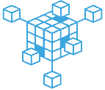
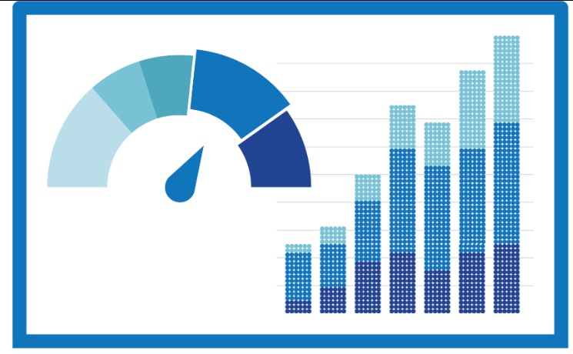
12
USE CASES
Digital
Experience
Demand
Generation
Orchestration /
Marketing Automation
Media / Ad
Optimization
Re-targeting on Alternate Channels
Suppression: Omni-channel experience
Persona based recommendations
Cross-sell based on Product Ownership
Buyers Journey: Email steps post specific interest
Re-engage Prospects
Automated Journeys
Journey-based Content Personalization
Scoring & routing
Media & Ad Spend Reports
Return On Investment
Channel Suppression based on performance

Slide 6
Why Salesforce to solve the use cases.
By integrating Salesforce Marketing Cloud, Salesforce Audience Studio with their digital channels, Kinetic Fashions will be able to:
Drive 1-1 multi channel customer journeys from Journey Builder by creating custom journey activities that allow for user flow based on membership level, loyalty, behavior across a journey.
Content Recommendation on website based on user’s browsing history, interests and past purchases using Evergage.
Real time personalization to re-engage customer on website using Evergage.
Activating Audiences using Audience Studio on Ad Studio, in SFMC and ad platforms directly to target and re-target customers with precision.
Enable Social listening to understand the brand sentiment using Social Studio
Analyze and optimize the media & ad spends based on insights & Reports generated from Datorama.

Slide 7

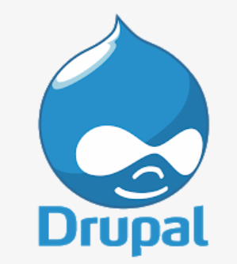
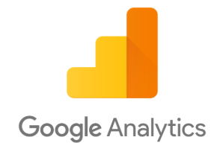



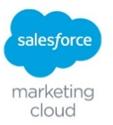



12
New Systems
New Integration
SOLUTION DESIGN
Existing Integration
Existing Systems
via. Tag Management Solution / analytics tracking pixels
website
CMS + Forms
Online Data Collection
Drupal Server
Personalized
Content
Web personalization
Product Catalog
Landing
Page
Customer mapping
API Integration
CRM
PAID MEDIA
(SEARCH, DISPLAY, SOCIAL)
MARKETING AUTOMATION
Lead create / update
Outbound Marketing
Sales Data feed
EMAIL
DMP
Outbound Email
Outbound Activation Channels
2nd Party
3rd Party
Datorama
Media & Ads Reporting
Media & Ads Data
Analytics & Campaign Data

Slide 8

Marketing Cloud Stack Used.
SFMC Stack
Experience
Journey Builder
Content Builder
Audience Builder
Einstein
Advertising Studio
Social Studio

Slide 9
IMPACT
The proposed solution will allow Kinetic Fashions to:
Understand their customers better through multi-channel communication.
Scale the marketing solution and efforts to meet the demand of the today with an eye on the future.
Create a Brand loyalty with precise 1:1 communication and suppression for uniform omni-channel experience.
Expand the horizon for acquiring new customers using ad platforms efficiently.
Plan , analyse and optimize the media & ad spending through real time campaign & Channel performance Reports.

Slide 10







































AUDIENCE OPTIMIZATION IN ACTION
INGEST
MANAGE
OMNI-CHANNEL
1st Party
Gender
MAL
E
FEMALE
Web ANALYTICS
Site
Marital Status
MARRI
ED
SING
LE
CRM
Presence of Children
NO
YES
Tagged Media
Site Process
BEGIN
NING
MIDDL
E
END
OUTDOOR
F
OODIE
TECHIE
Engaged Gadget Moms
(1.5M Uniques) Last 7 Days
Mobile
Lifestyle
2nd Party
Job Function
EXECUTI
VE
MARK
ETING
SALES
Pages Consumed
1-
5
6-10
10+
Partner Data
Display
Video Engagement
YES
NO
Age
18-3
4
35-55
5
5+
3rd Party
In-Store Purchase
YES
NO
In-Market Outdoor Males (2.4M Uniques) Last 7 Days
Video
TARGUSinfo Datalogix Exelate AddThis
epsilon Experian V12 group LiveRamp
bizo Alliant IXI
Acxiom
HH Income
<$5
0K
>$50K
>$10
0K
Travel Type
B
usiness
L
eisure
Credit Card Usage
<$1K
$1-5K
>$10K+
Email

Slide 11

12

Slide 12
Thank You

